Slide 1







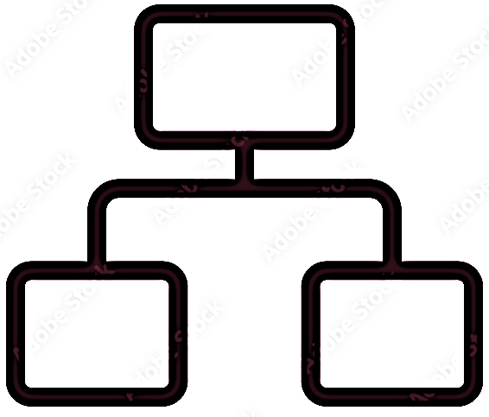




EMBEDDED SYSTEMS WORKSHOP
INDOOR
AIR POLLUTION
TEAM 13
K. Lakshmi Nirmala (2021101126)
Abhinay Maurya (2021101132)
V. Siva Koti Reddy (2021101135)
Abid Khursheed (2021101136)

Slide 2
Motivation:
Indoor Air pollution and health:
Indoor air pollution is considered one of the top 5 environmental health risks. In developing countries, indoor air pollution from solid fuel use is the primary cause of illness and premature death.
According to the World Health Organization, over 3 billion people cook and heat their homes using solid fuels such as wood, charcoal, dung, and crop wastes.
Women and young children are particularly affected because they spend the most time near the domestic hearth.
Inhalation of smoke from solid fuel use is a major risk factor for pneumonia, chronic obstructive pulmonary disease, lung cancer, and other illnesses. [Source: WHO]

Slide 3
Structure of the project:
Our Project presents a solution for monitoring various indoor air particle levels and Consists of three modules
I
Ii
Iii
On ground Sensors
Sensors which were collecting data about temperature,VOCs and PM in room
Resource Server
Data values collecting from thingspeak and onem2m
Data Pipelining
Dashboard
Outliers,Validation
Alert System

Slide 4
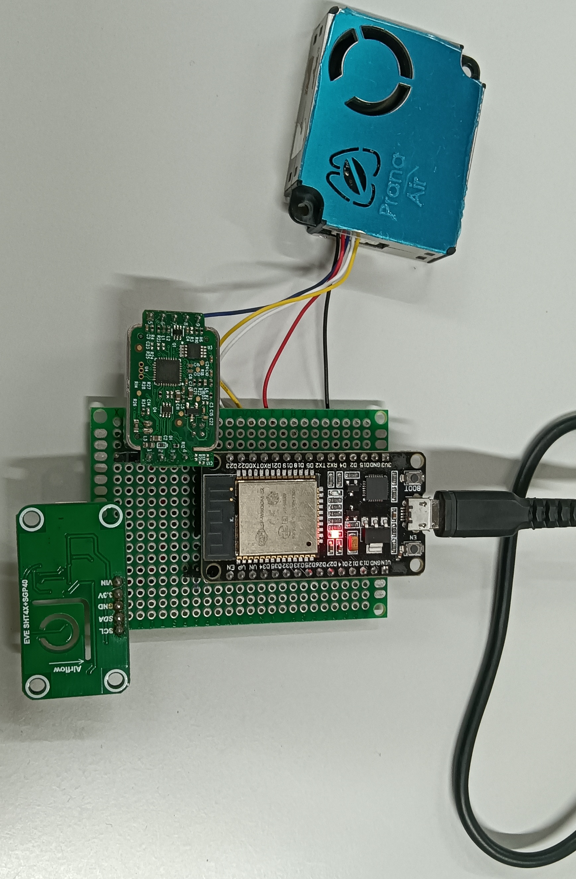
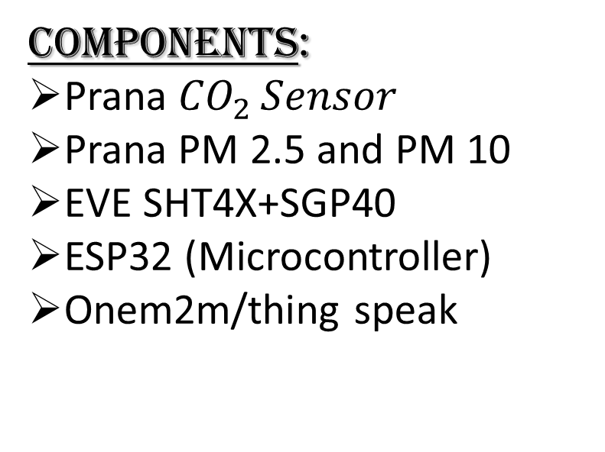
Components:
Prana ${CO}_{2}{Sensor}$
Prana PM 2.5 and PM 10
EVE SHT4X+SGP40
ESP32 (Microcontroller)
Onem2m/thing speak

Slide 5
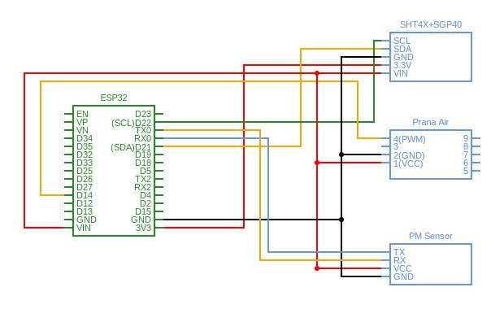
Actual Circuit Diagram:

Slide 6


BLOCK DIAGRAM:
Prana Air
sensor
Dashboard
EVE
SHT4X+SGP40
Thingspeak/
Onem2m
ESP32
Alert System
PM sensor

Slide 7
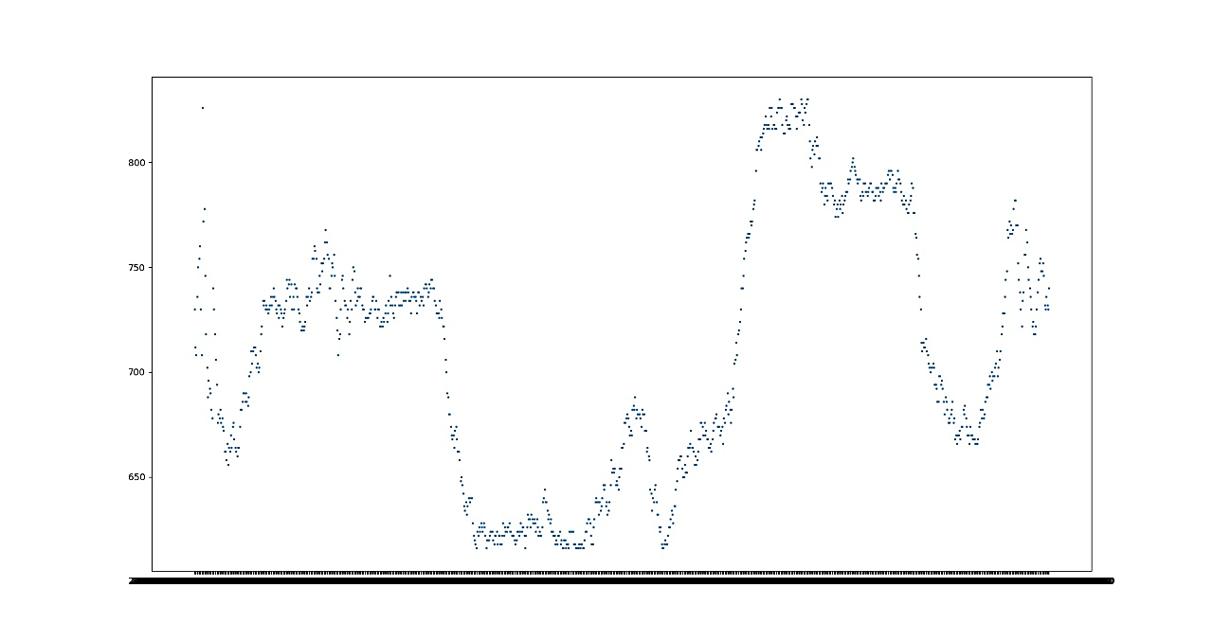
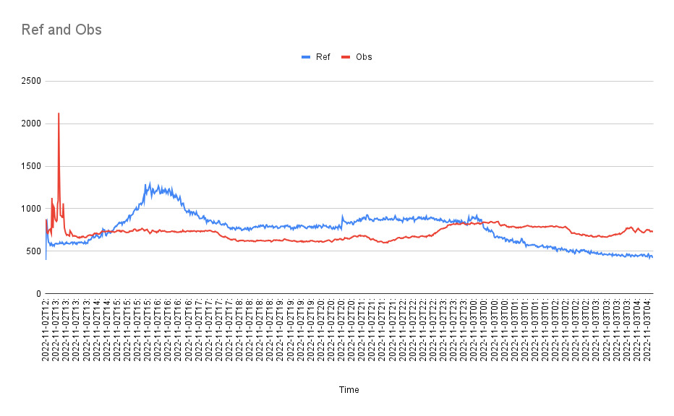
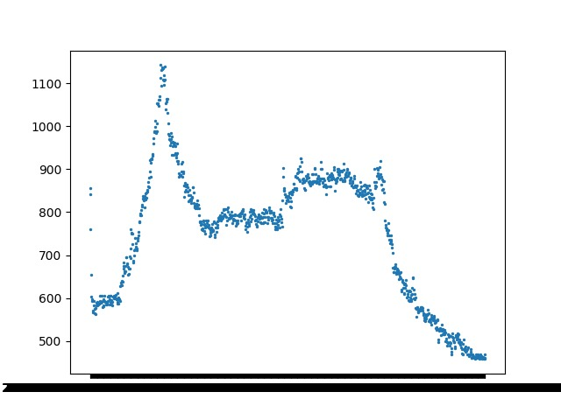
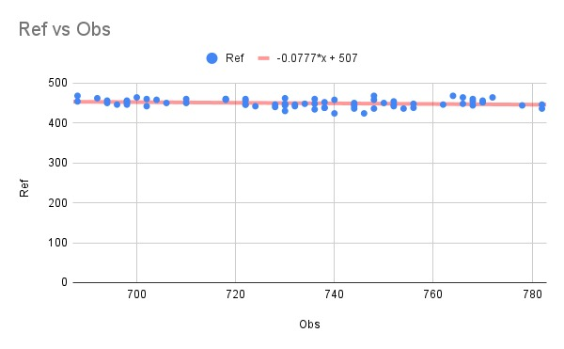
Node vs Reference of CO2
Outlier Detection
Outlier detection for observed node:
Outlier detection for reference node:
Calibration:

Slide 8
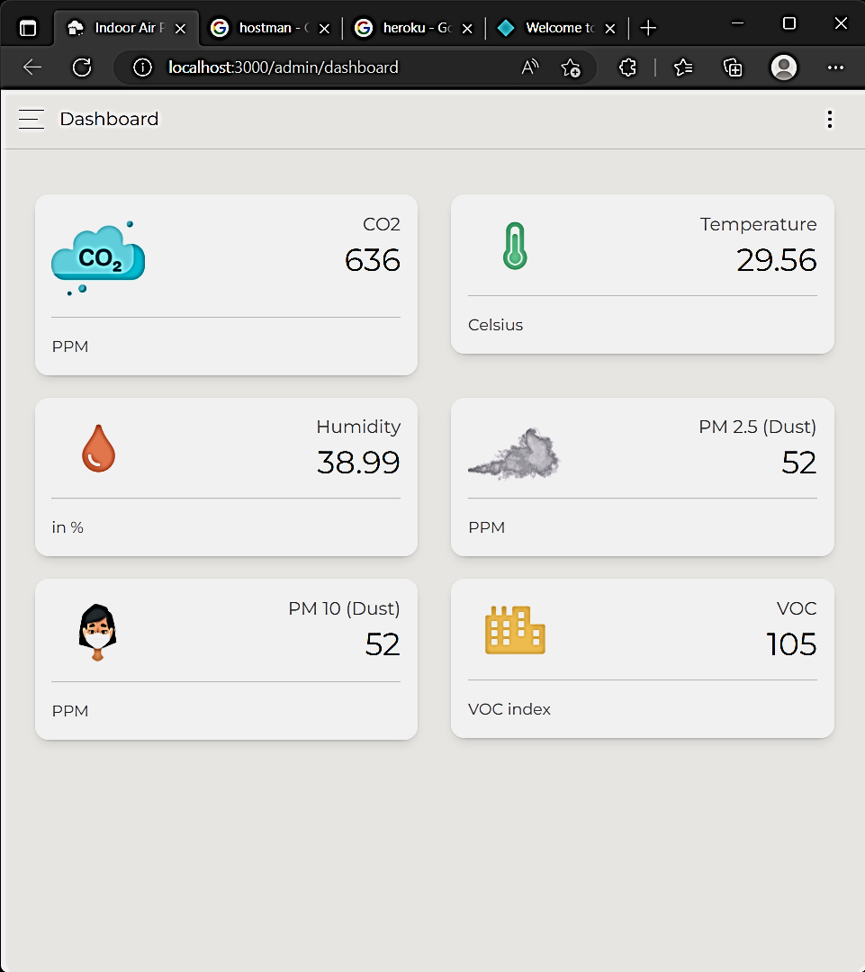
DASHBOARD VISUALISATION:

Slide 9
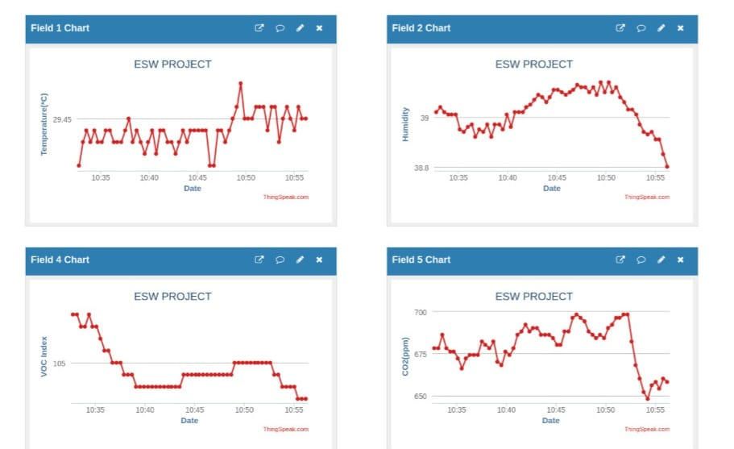
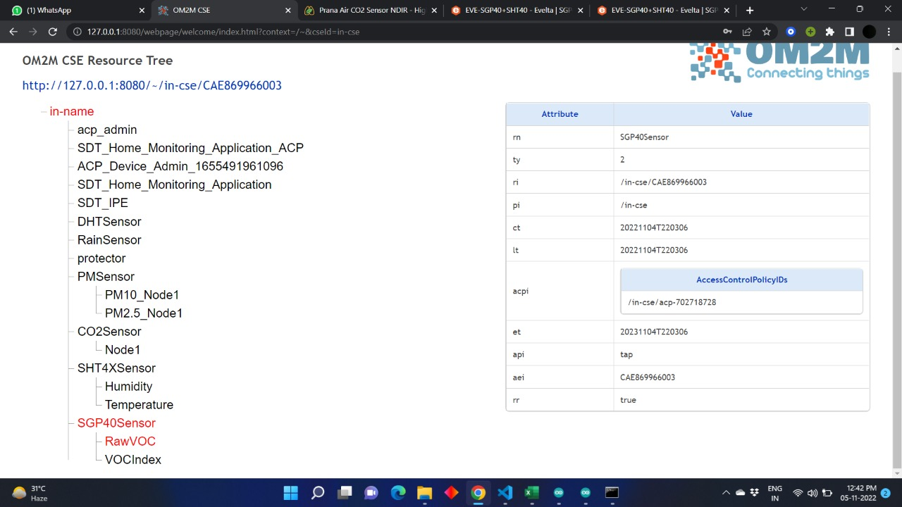
ONEM2M:
THINGSPEAK:

Slide 10
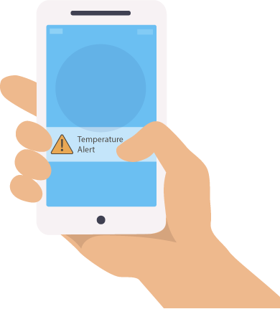
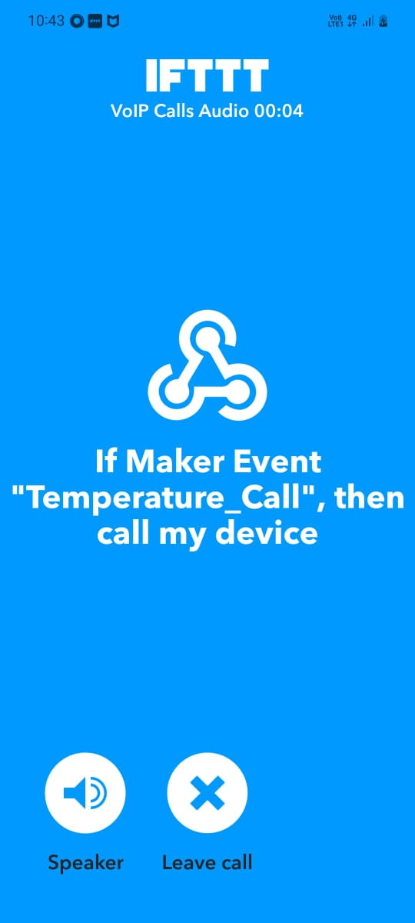
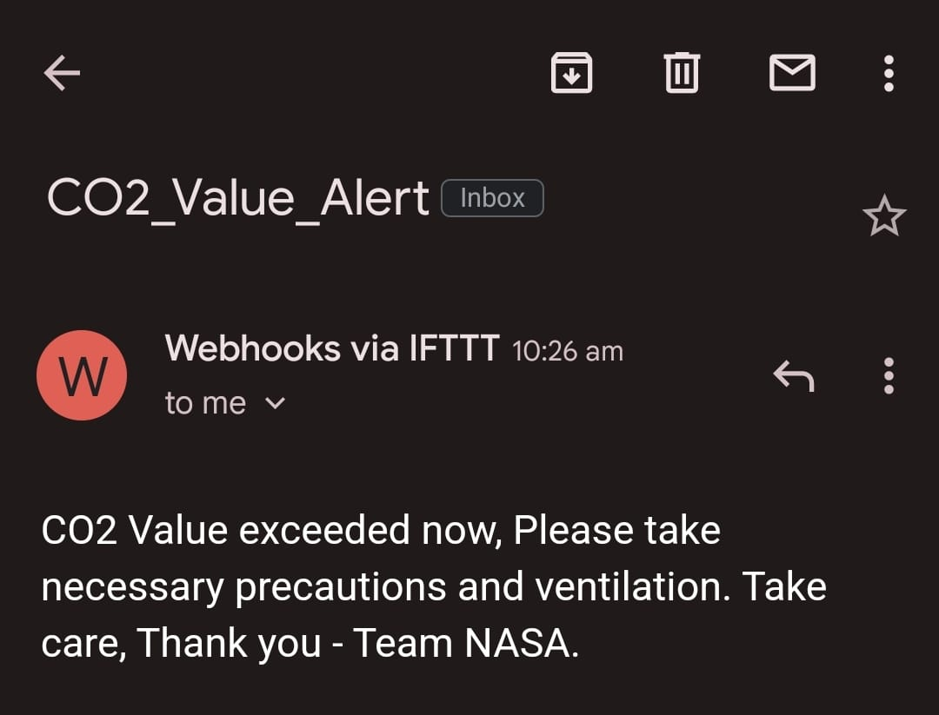

ALERT SYSTEM:
By monitoring sensor values and observing threshold of that particular gas or molecules we are alerting people about the values of co2 and pm. By using IFTT.com source we implemented temperature_Call-temperature if there is any increase in temperature and giving temperature report
to the Email

Slide 11
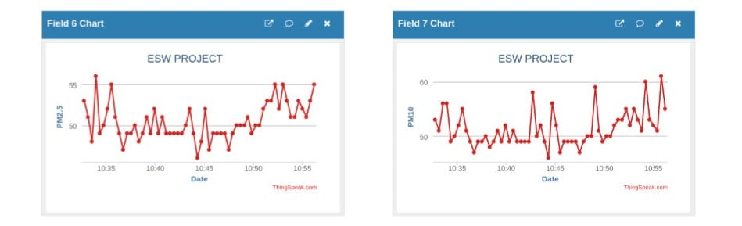
<-Onem2m
Alert System->

Slide 12

THANK YOU..
Have a good day😊😊

